Slide 1


Grade 8 Access
Reading – Vocabulary – Grammar
Final Term 3 Exam Revision
Teacher Nadia Al Abdouli

Slide 2
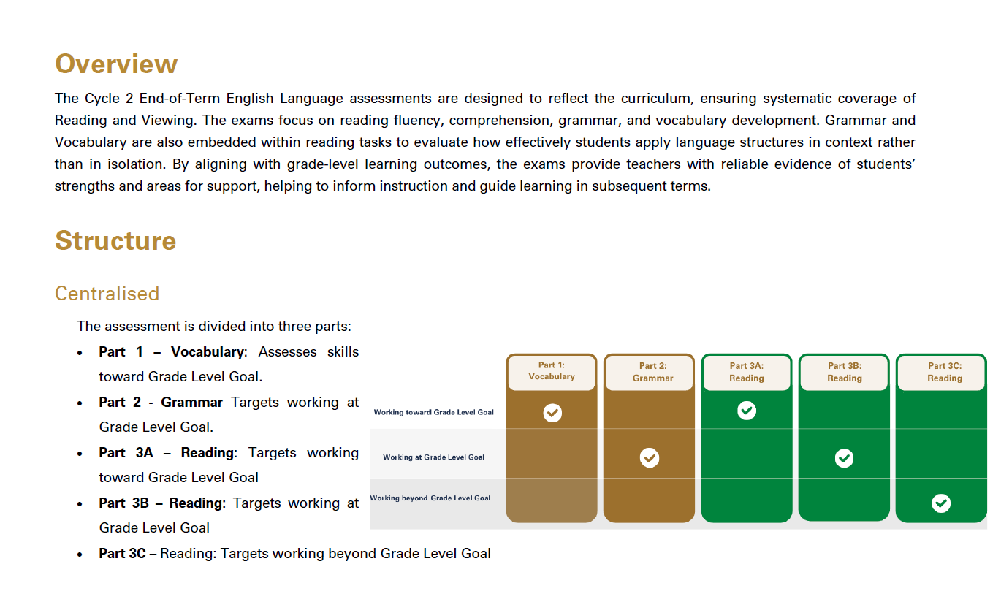

Slide 3
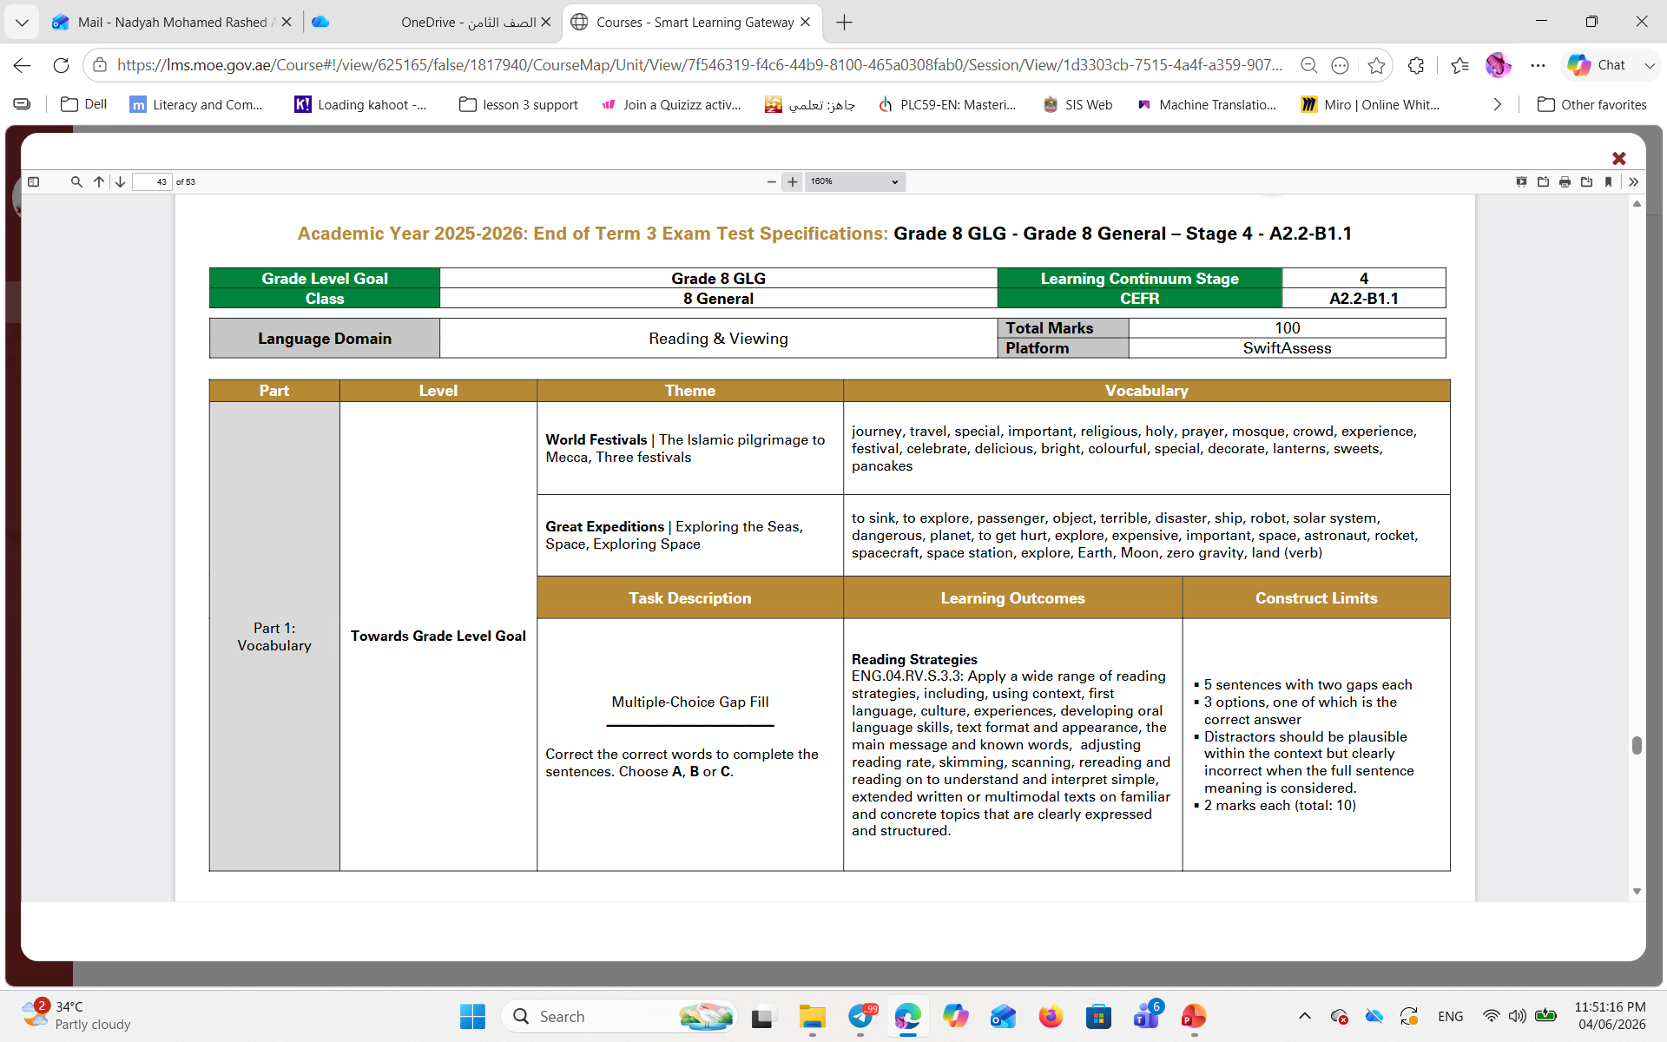
Part 1: Vocabulary: Towards Grade Level (10 marks)

Slide 4
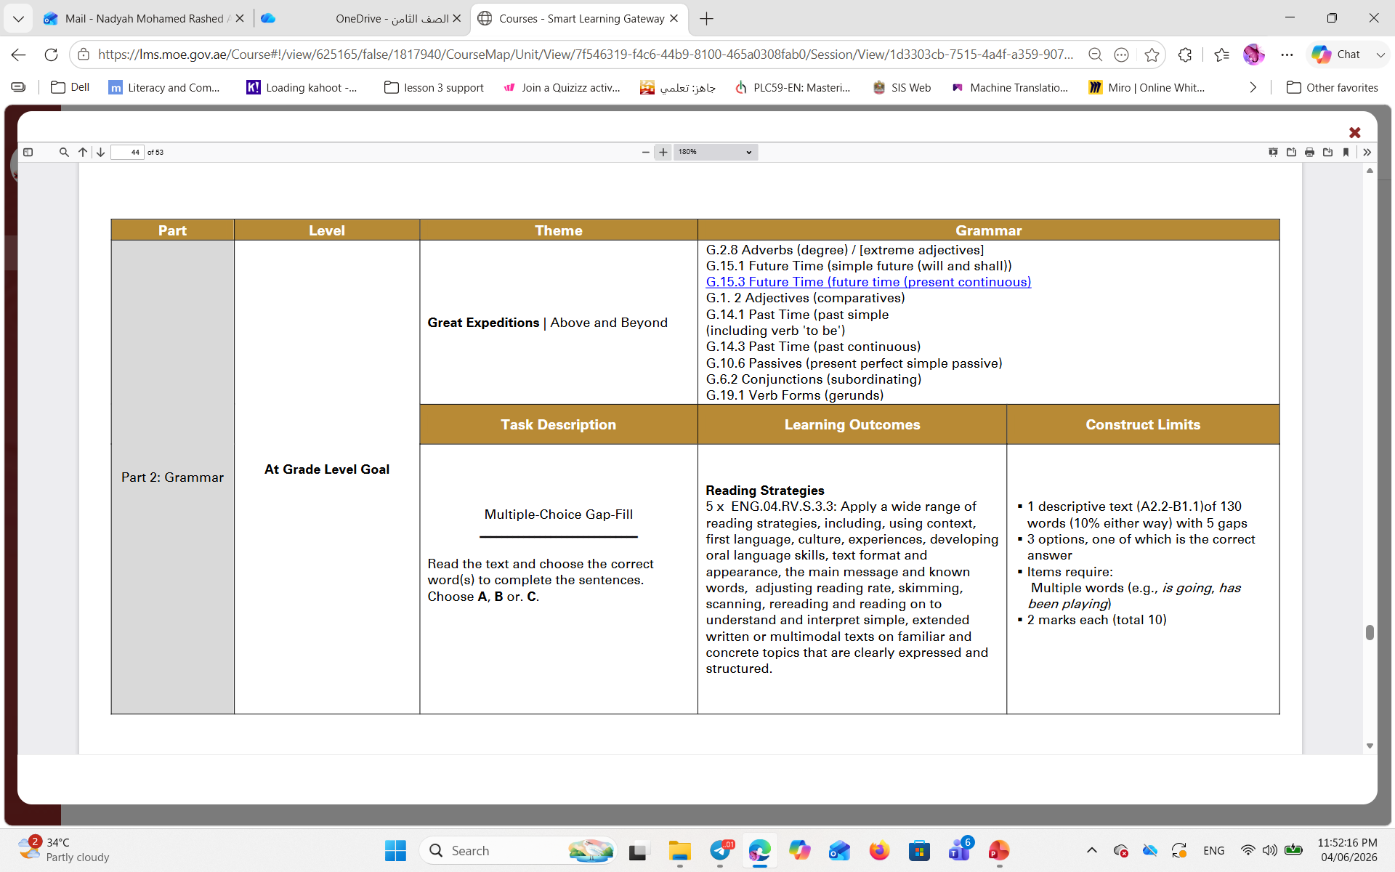
Part 2: Grammar - At Grade Level (10 Marks)

Slide 5
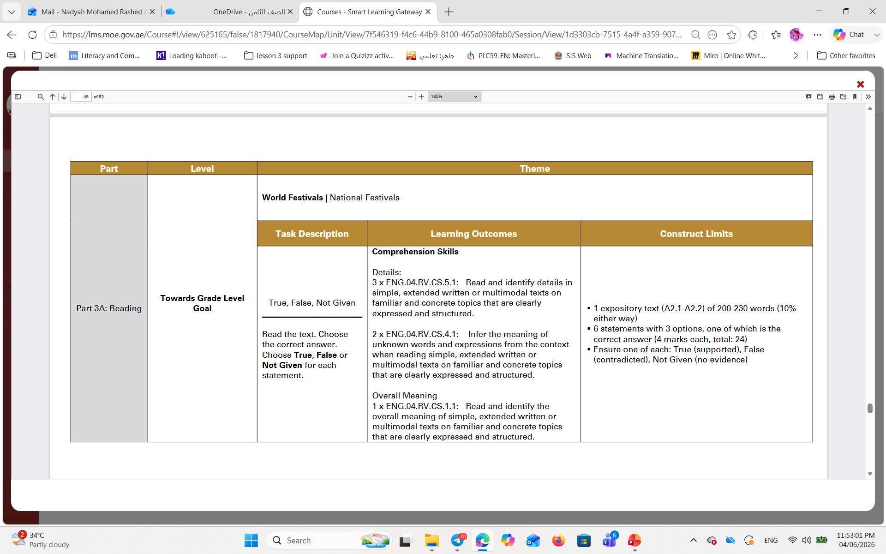
Part 3A: Reading - Towards Grade Level - (24 Marks)

Slide 6
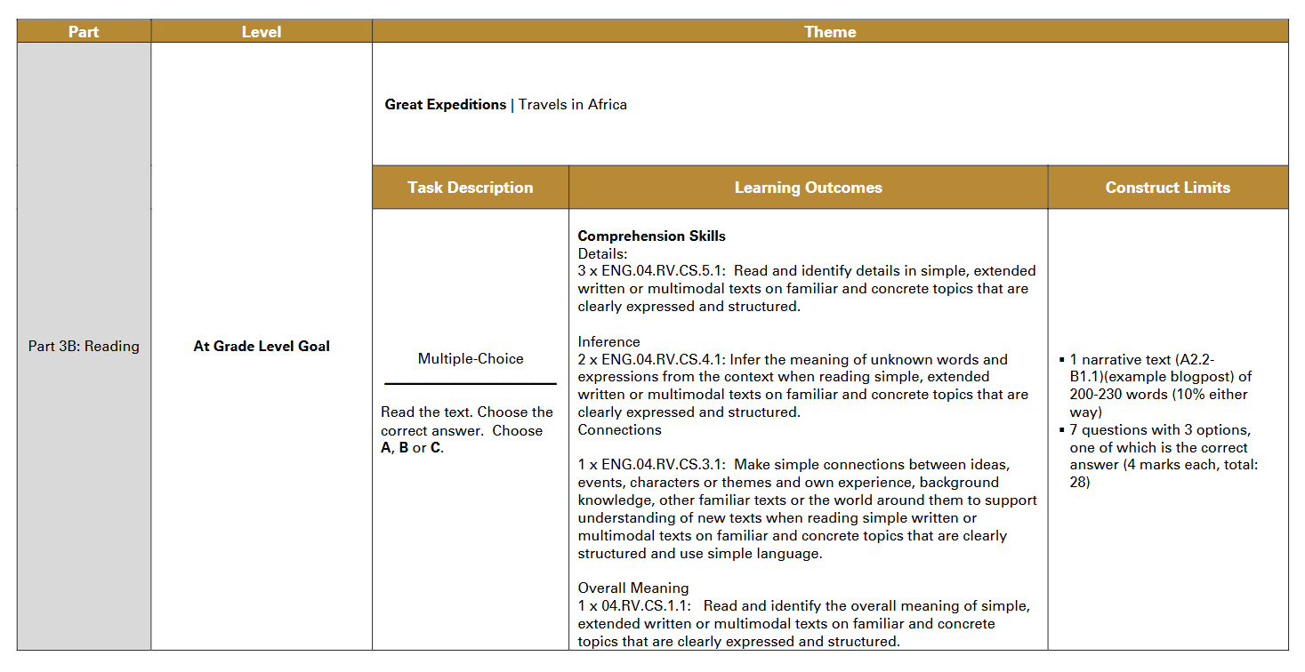
Part 3B: Reading- At Grade Level Goal- (28 Marks)

Slide 7
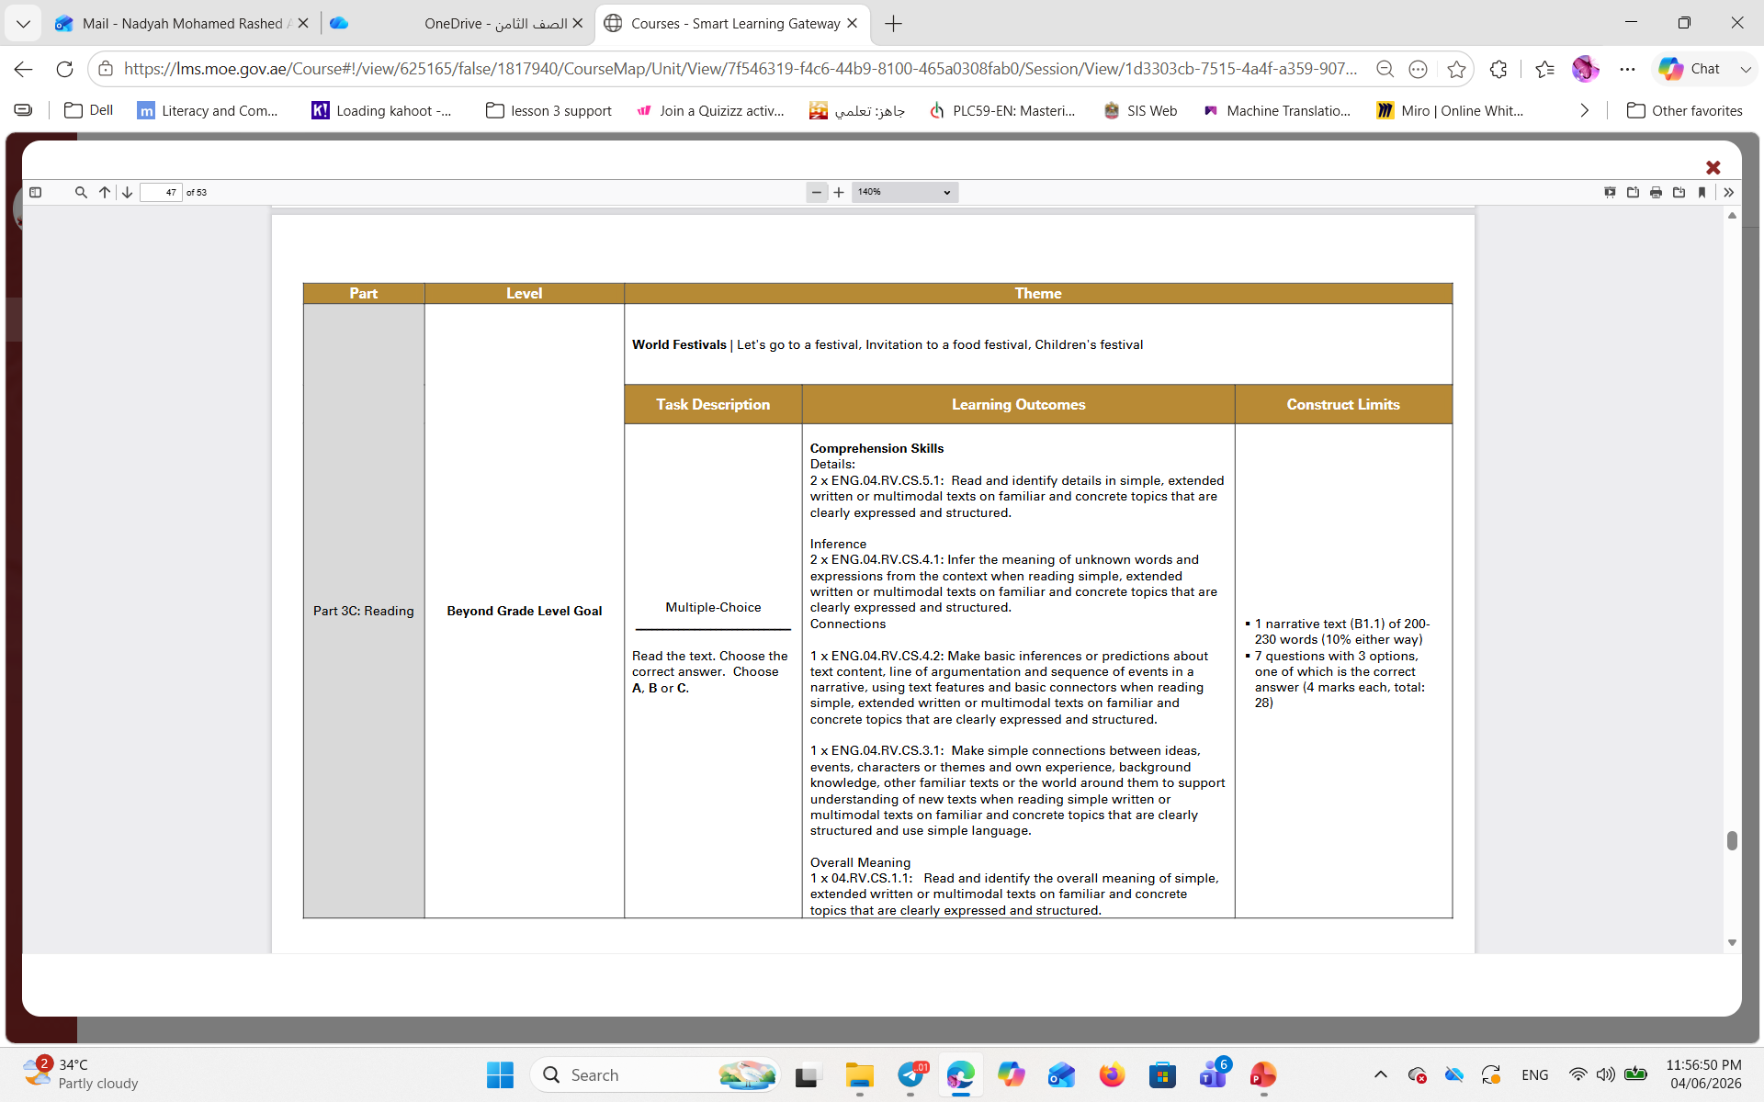
Part 3C: Reading- Beyond Grade Level Goal- (28 Marks)

Slide 8
THANK
YOU!

